Slide 1

SiMa.ai Brand Guidelines V1
2023

Slide 2
Logo
12 Overview
13 Logomark
14 Color variations
17 Clear space and minimum sizing
18 Things to avoid
Logo

Slide 3
Overview
Logo
Our primary logo is the SiMa.ai wordmark, shown above. The abstracted “S” shape logomark speaks to the convergence of ideas, data in motion, chips, and simplicity.
The colors of our logo are inspired by the mineral Silica. The colors reflect the diversity and energy of both SiMa.ai’s applications and people. Our logo is the main signifier of our brand and the first point of contact for external audiences.

Slide 4

Logomark
Logo
The logomark may be used in applications where SiMa.ai is already well known and the logomark is identifiable, or after the primary logo has already been introduced and this is the second instance of its use.

Slide 5
Color Variations
Logo
The SiMa.ai logo should be used in full color whenever possible. Never use the color logo on solid color backgrounds or black backgrounds.
Use:
Gray or white backgrounds
Larger sizes

Slide 6



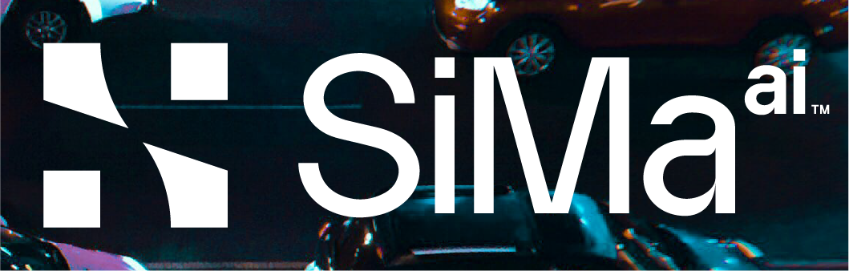
Solid Variations
Logo
Use the solid variation of the logo at small sizes where the legibility of the full-color logo would be compromised or on top of a color or photo background.
Use:
Black or dark backgrounds
Color backgrounds
Photo backgrounds
Small sizes

Slide 7

Grayscale Variations
Logo
When printing in black and white, or any other instance where the logo needs to be grayscale, be sure to use the grayscale version of the logo.
Use:
Printing in grayscale

Slide 8


Logo Clear Space & Minimum Sizing
1.25 INCH WIDE: MINIMUM PRINT SIZE
80 PX WIDE: MINIMUM DIGITAL SIZE
Logo
Clear Space: The SiMa.ai logo should be surrounded by generous white space to keep it clear and uncluttered. The white space is defined by the width of 1 squares from the logo. This is the minimum space that should remain clear of other elements.
Minimum Sizing: To maintain legibility, the wordmark should not appear smaller than 80px wide in digital formats or 1.25 inches for print.

Slide 9






Things to avoid
DO NOT: Stretch the logo
DO NOT: Add effects to the logo
DO NOT: Use the solid version of the logo in any color but black or white
Logo
DO NOT: Use the logo on a busy background
DO NOT: Use unapproved color combinations
DO NOT: Use the full color logo on black or any colored background.
The SiMa.ai logo is the main signifier of the brand and should be handled with care. Never change the logo. It’s very happy as it is.

Slide 10
Color Palette
20 Overview
21 Primary colors
22 Accent colors
23 Things to avoid
Color Palette

Slide 11
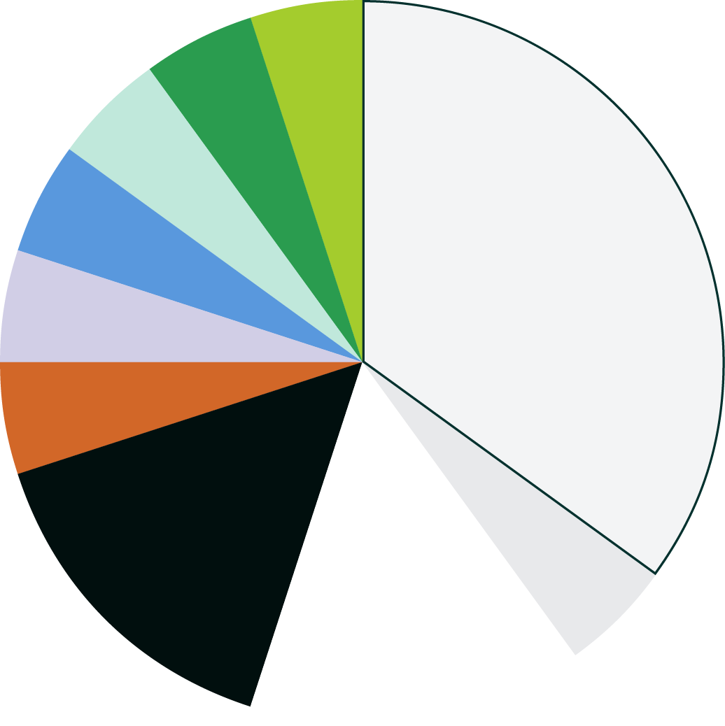
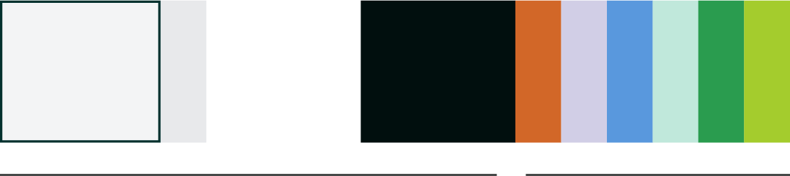
Overview
70%
30%
Color Palette
Our color palette is a balance of beautiful color and grounding neutrals. The color distribution of the palette is mainly gray, white, and black. The secondary colors are used considerably less, but can add a pop of color or be used as an occasional background.
Your compositions should feel similar in color to the color distribution above.

Slide 12
Primary Colors
TRIDYMITE GRAY
GALENA GRAY
CRISTOBALITE WHITE
CARBIDE BLACK
HEX: #F3F4F5
RGB: 243, 244, 245
CMYK: 4, 2, 2, 0
PMS: 5315 U
HEX: #E8E9EB
RGB: 232, 233, 245
CMYK: 8, 5, 4, 0
PMS: 5305 U
HEX: #FFFFFF
RGB: 250, 250, 250
CMYK: 0, 0, 0, 0
HEX: #010F0E
RGB: 1, 15, 14
CMYK: 80, 64, 67, 83
PMS: Black 6 U
Color Palette
Our primary background color should be Tridymite Gray, but Cristobalite White is also acceptable. Use black backgrounds sparingly. Black should be used primarily for text and for the ruling lines.
The purpose of this color palette is to balance out the brightness and contrast of the secondary palette. These colors help to ground other pops of color.

Slide 13
Accent Colors
JASPER RED
QUARTZ LAVENDER
OPAL BLUE
COESITE TEAL
CHALCEDONY GREEN
LECHATELIERITE LIME
HEX: #D26728
RGB: 210, 103, 40
CMYK: 7, 76, 100, 1
PMS: 717 U
HEX: #D1CEE6
RGB: 209, 206, 230
CMYK: 16, 16, 0, 0
PMS: 2085 U
HEX: #5998DD
RGB: 89, 152, 221
CMYK: 68, 29, 0, 0
PMS: 279 U
HEX: #C0E8DB
RGB: 192, 232, 219
CMYK: 27, 0, 18, 0
PMS: 628 U
HEX: #2A9C4F
RGB: 42, 156, 79
CMYK: 91, 8, 100, 1
PMS: 2257 U
HEX: #A4CC2D
RGB: 164, 204, 45
CMYK: 46, 0, 100, 0
PMS: 366 U
Color Palette
Use accent colors more sparingly than the primary colors. They’re effective to draw attention to a certain part of a composition, an important word or piece of copy, or to break up large blocks of gray/white in a composition.
Try to use a range of these secondary colors, not favoring one over the other. The ratio of secondary colors in a composition should roughly follow the ratio illustrated by the color wheel in slide 21.

Slide 14
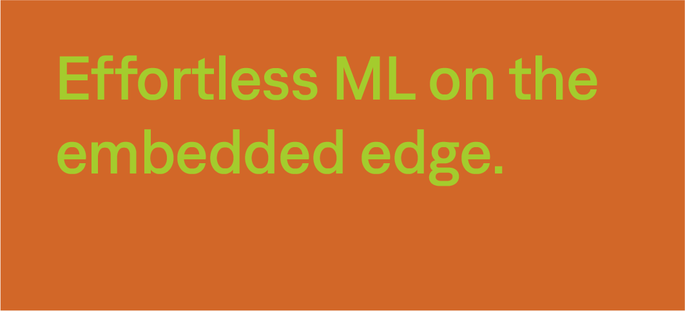
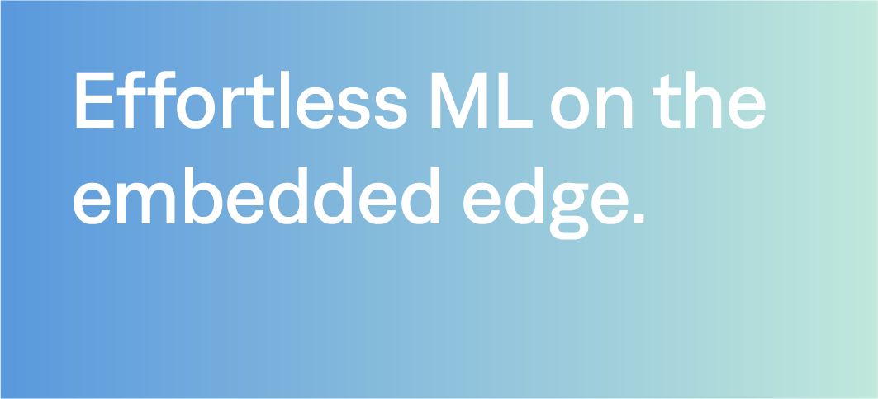
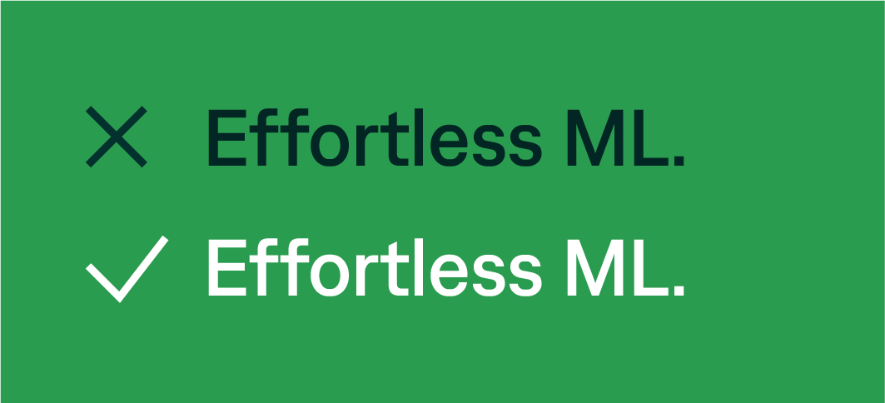
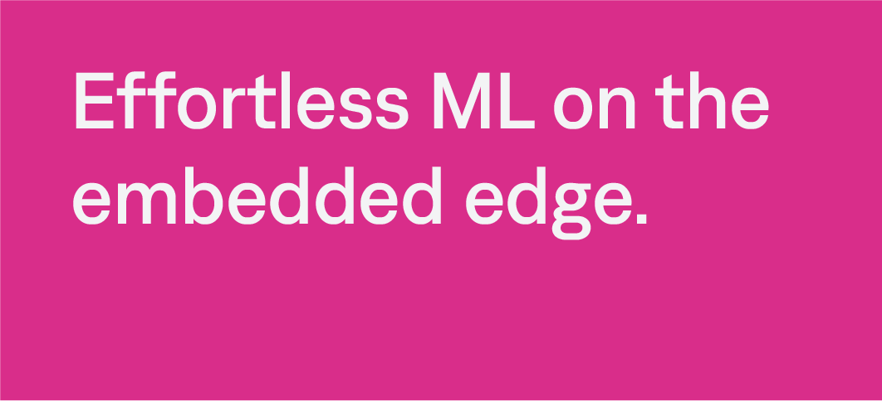
Things to avoid
DO NOT: Use colored text on a colored background
DO NOT: Use the colors as gradients
Color Palette
DO NOT: Use text/background pairings that are not approved / ADA compliant (see slide 29)
DO NOT: Use colors outside the brand palette.
Our color helps signify our brand and should be handled with care. Never use color in any of these ways.

Slide 15
Typography
25 Overview
26 Type Hierarchy
27 Substitute Fonts
28 Color and Type
29 Things to Avoid
Typography

Slide 16
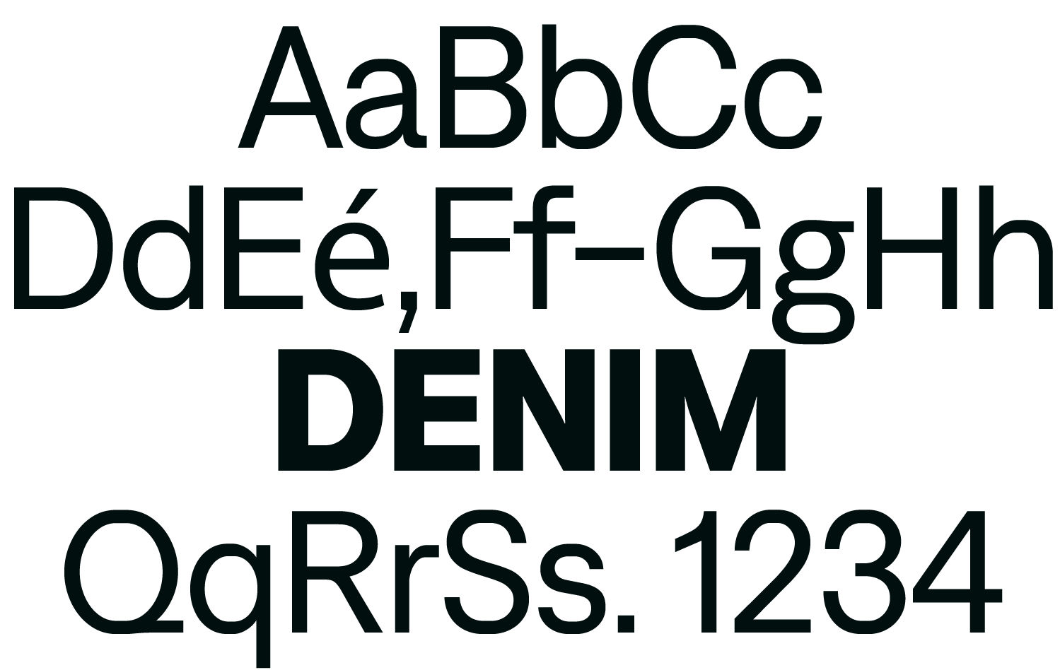
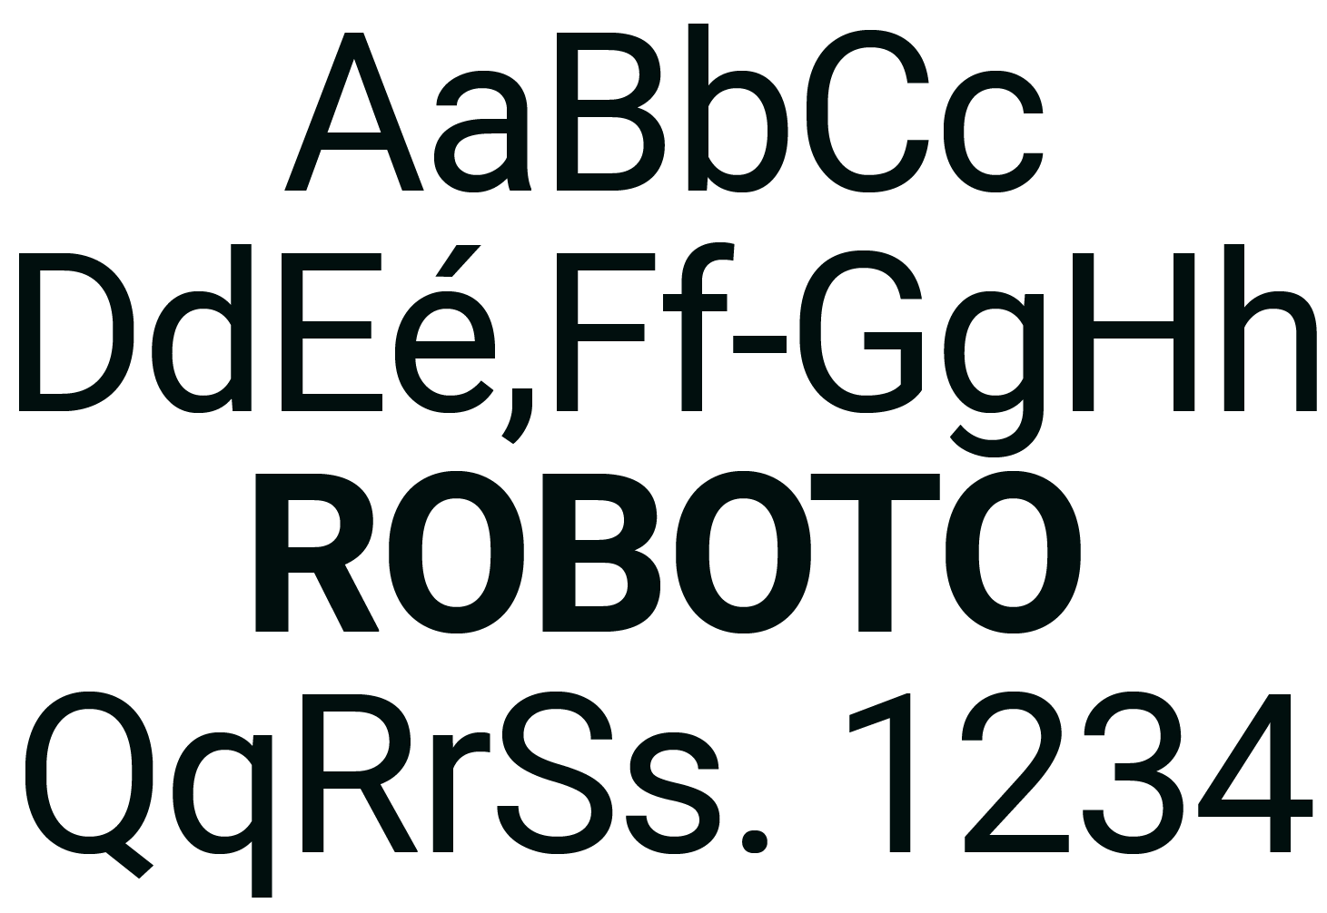
Overview
Typography
Our primary brand typeface is Denim, which suits any situation and is primarily used in marketing materials created by a graphic designer. Because of its narrow proportions, it works well in smaller spaces where space is limited.
Our brand also utilizes the typeface Roboto at smaller sizes, in body copy and callouts.This is the font employees will use for documents, presentations and most everything else. It is widely available in Google docs and can be downloaded to be used with Microsoft Office products.

Slide 17
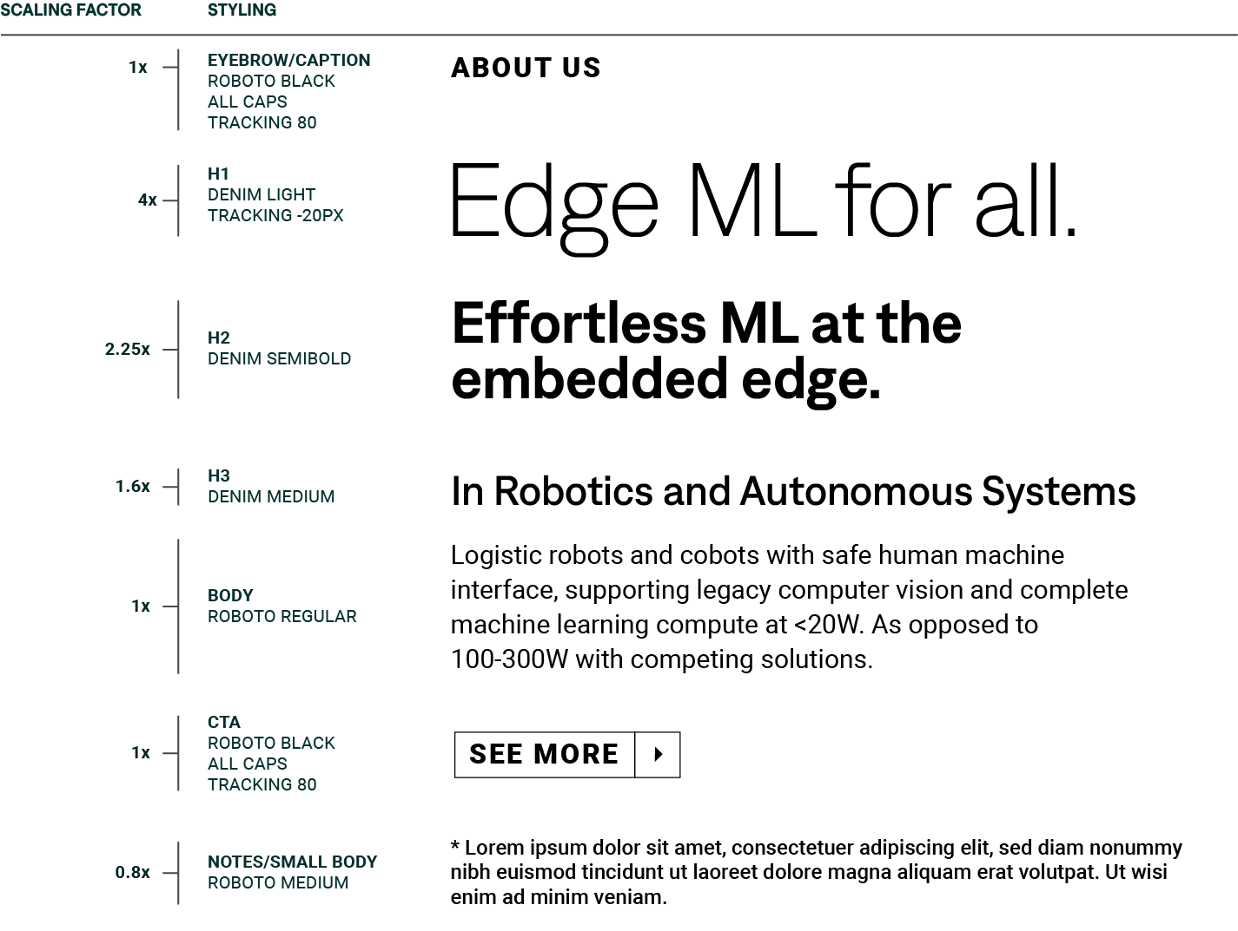
Hierarchy
Typography
When creating a composition, begin with the appropriate size of the body copy for the composition.
From there, the rest of the type hierarchy is determined based on the scaling factor x the size of the body copy.
This hierarchy helps our brand material feel cohesive. Use this type hierarchy as a guide, and your best-judgment when it’s necessary to deviate from it.

Slide 18
Substitute Fonts
ROBOTO
Edge ML for all.
Effortless ML for the embedded edge.
Typography
In situations where Denim is unavailable for use, Roboto may be used in headlines and body copy. Roboto can be found in Google docs and slides and can be downloaded to be used with Microsoft Office. You can download it from google fonts here.
If only system fonts are available, please use Avenir or Sans Serif.

Slide 19
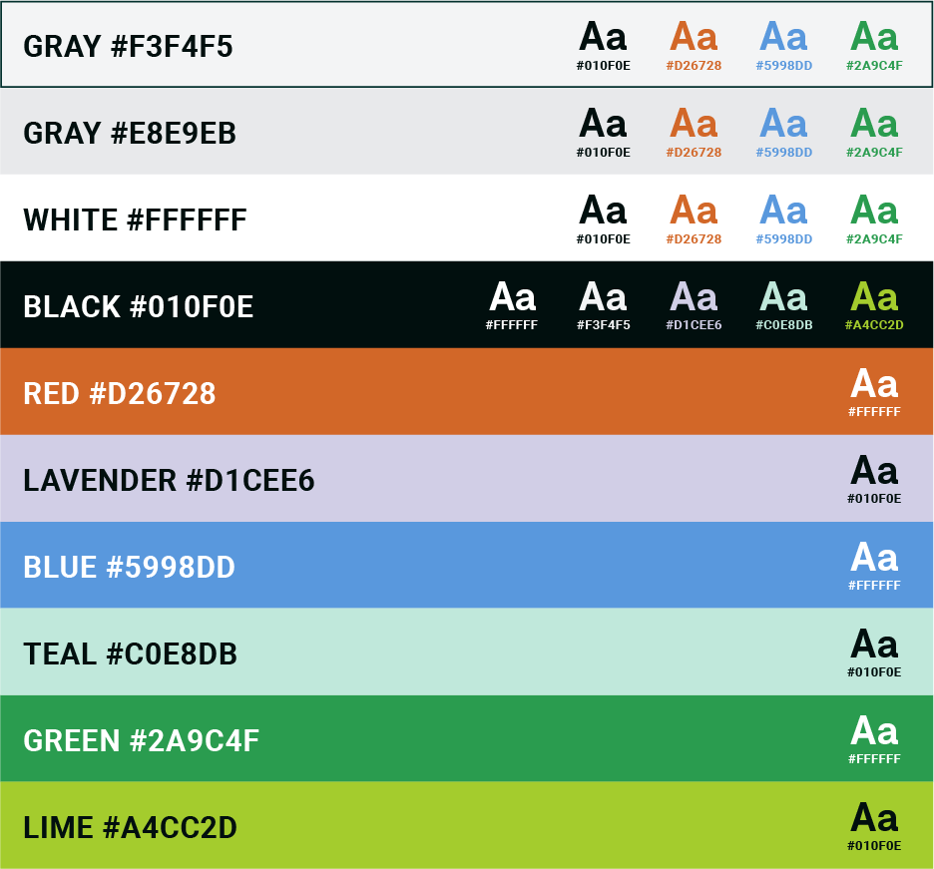
Color and Type
BACKGROUND COLOR
TEXT COLORS
Typography
These approved color and background pairings have enough legibility for ADA compliance. Refer to slides 21-22 for specific hex codes. Do not use any color pairings besides these.

Slide 20
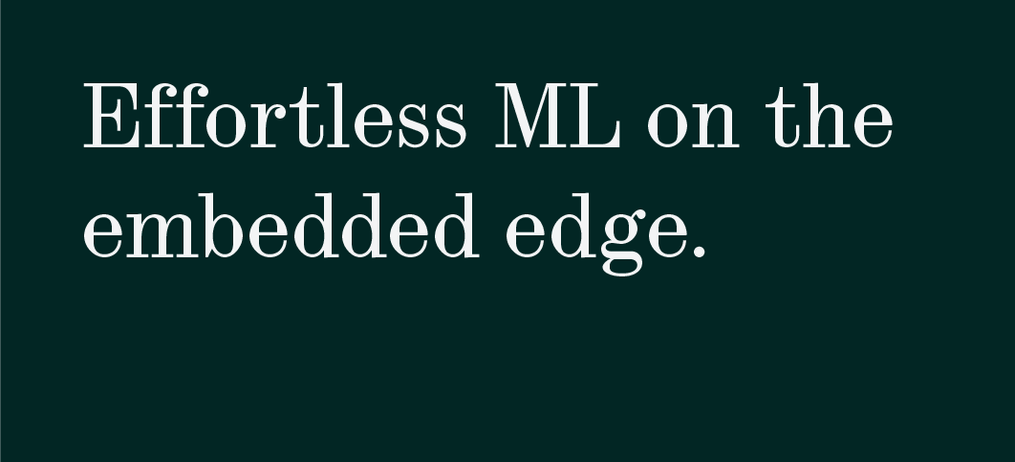
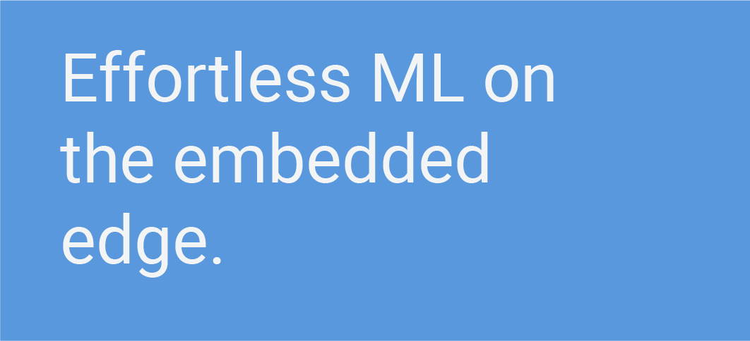
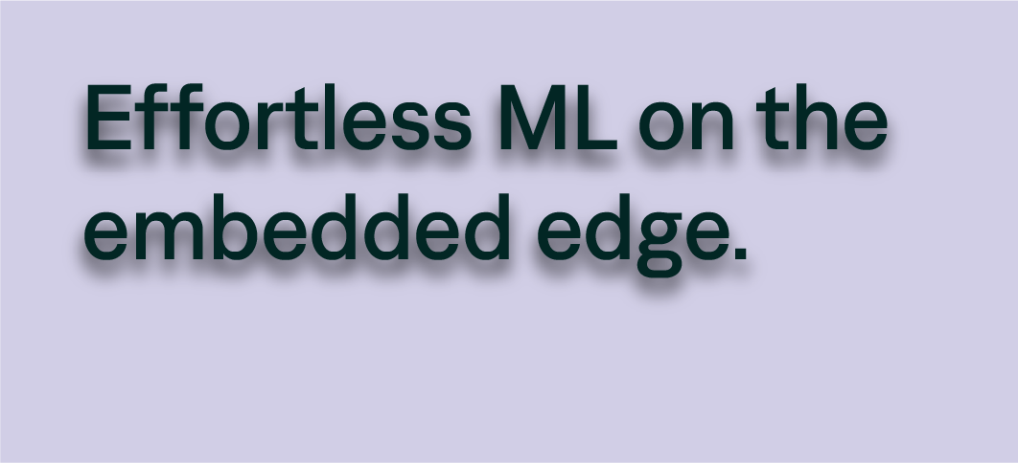
Things to avoid
DO NOT: Use colored text on a colored background
DO NOT: Use fonts other than the brand font.
DO NOT: Use use Roboto for headers or large copy.
Typography
DO NOT: Use text/background pairings that are not approved / ADA compliant (see slide 32)
DO NOT: Add effects to typography.
Our typography helps signify our brand and should be handled with care. Never use typography in any of these ways.

Slide 21
Photography
43 Overview
43 Human + Technology Imagery
44 Technology Imagery

Slide 22
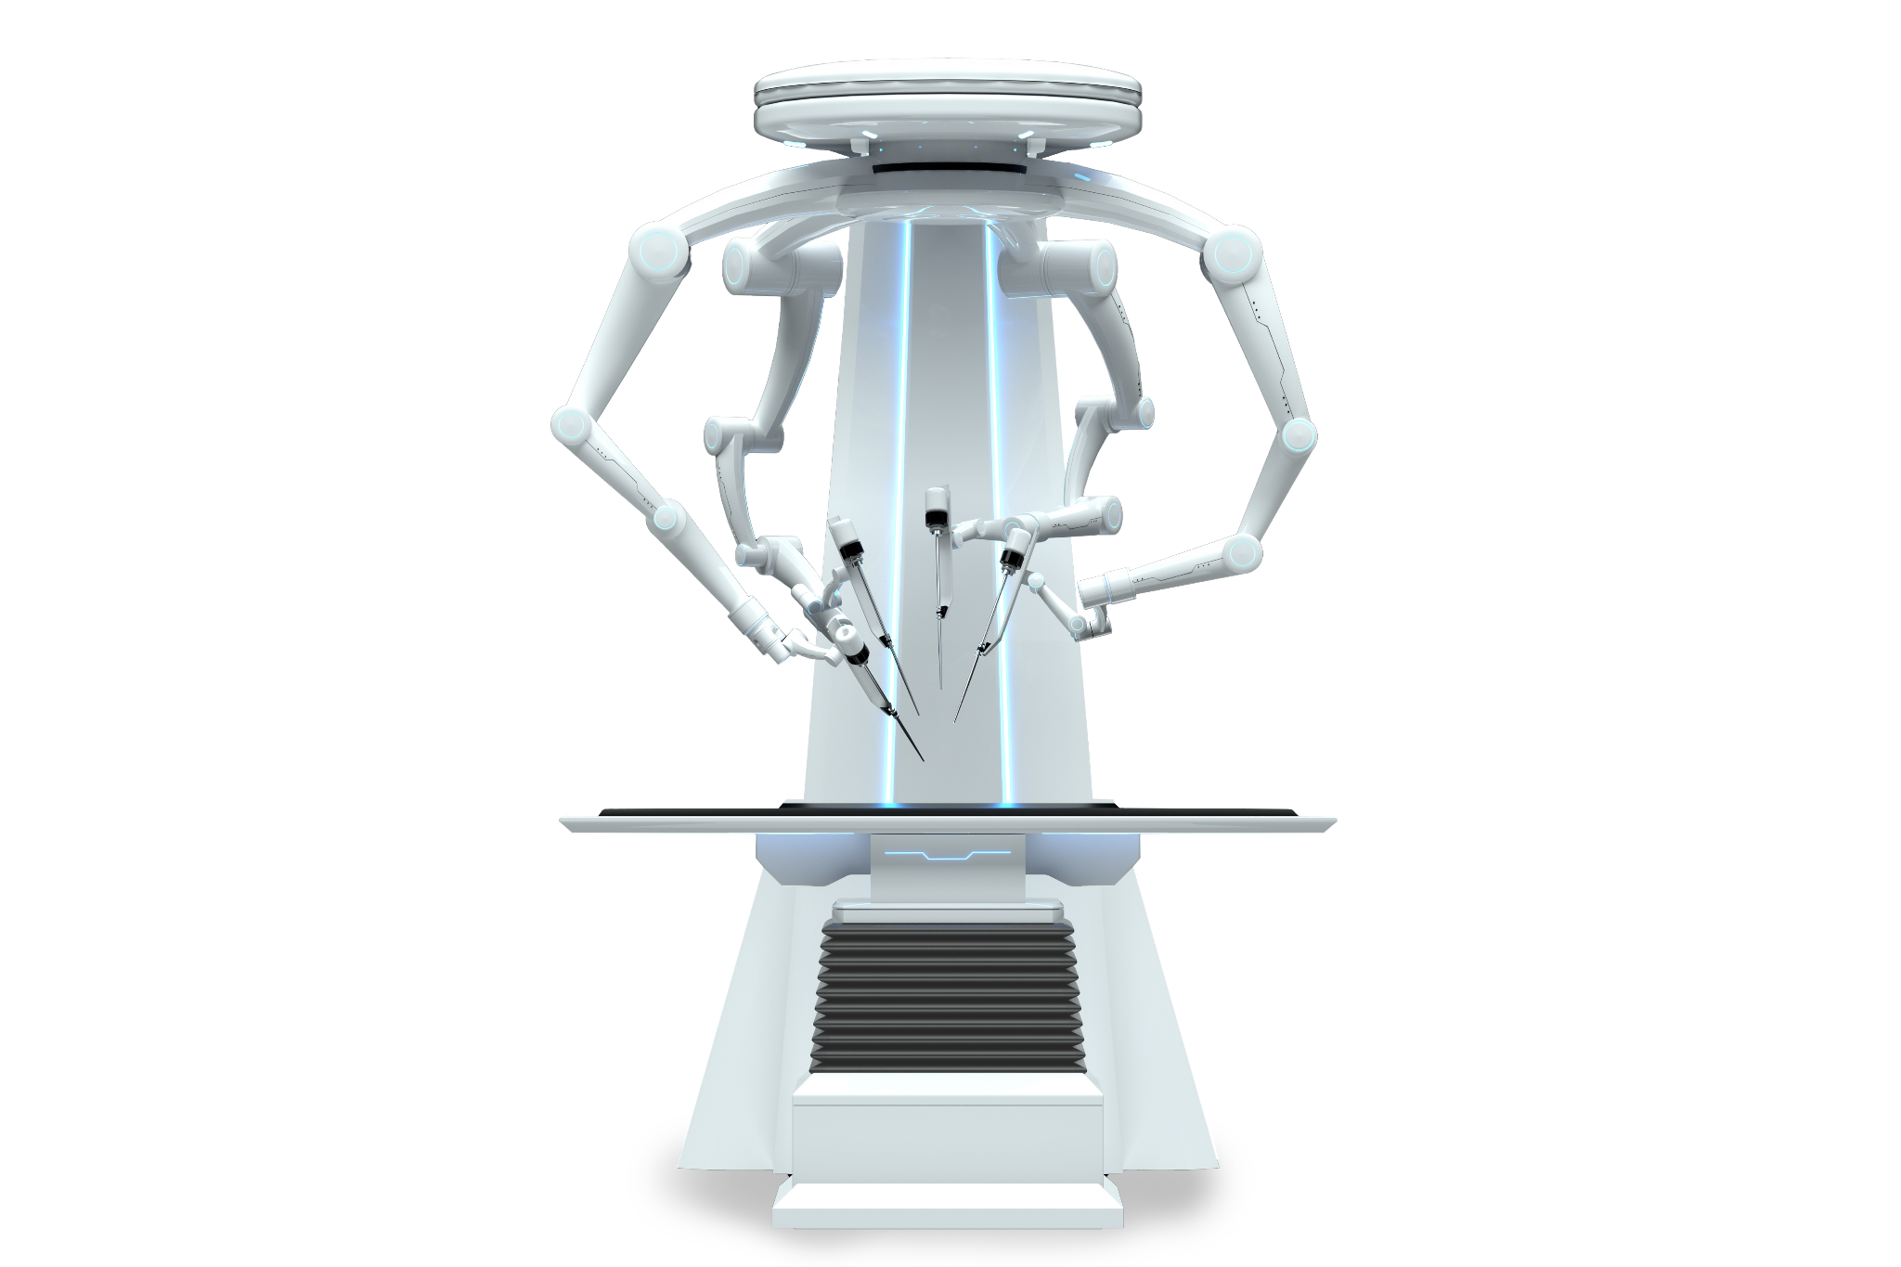
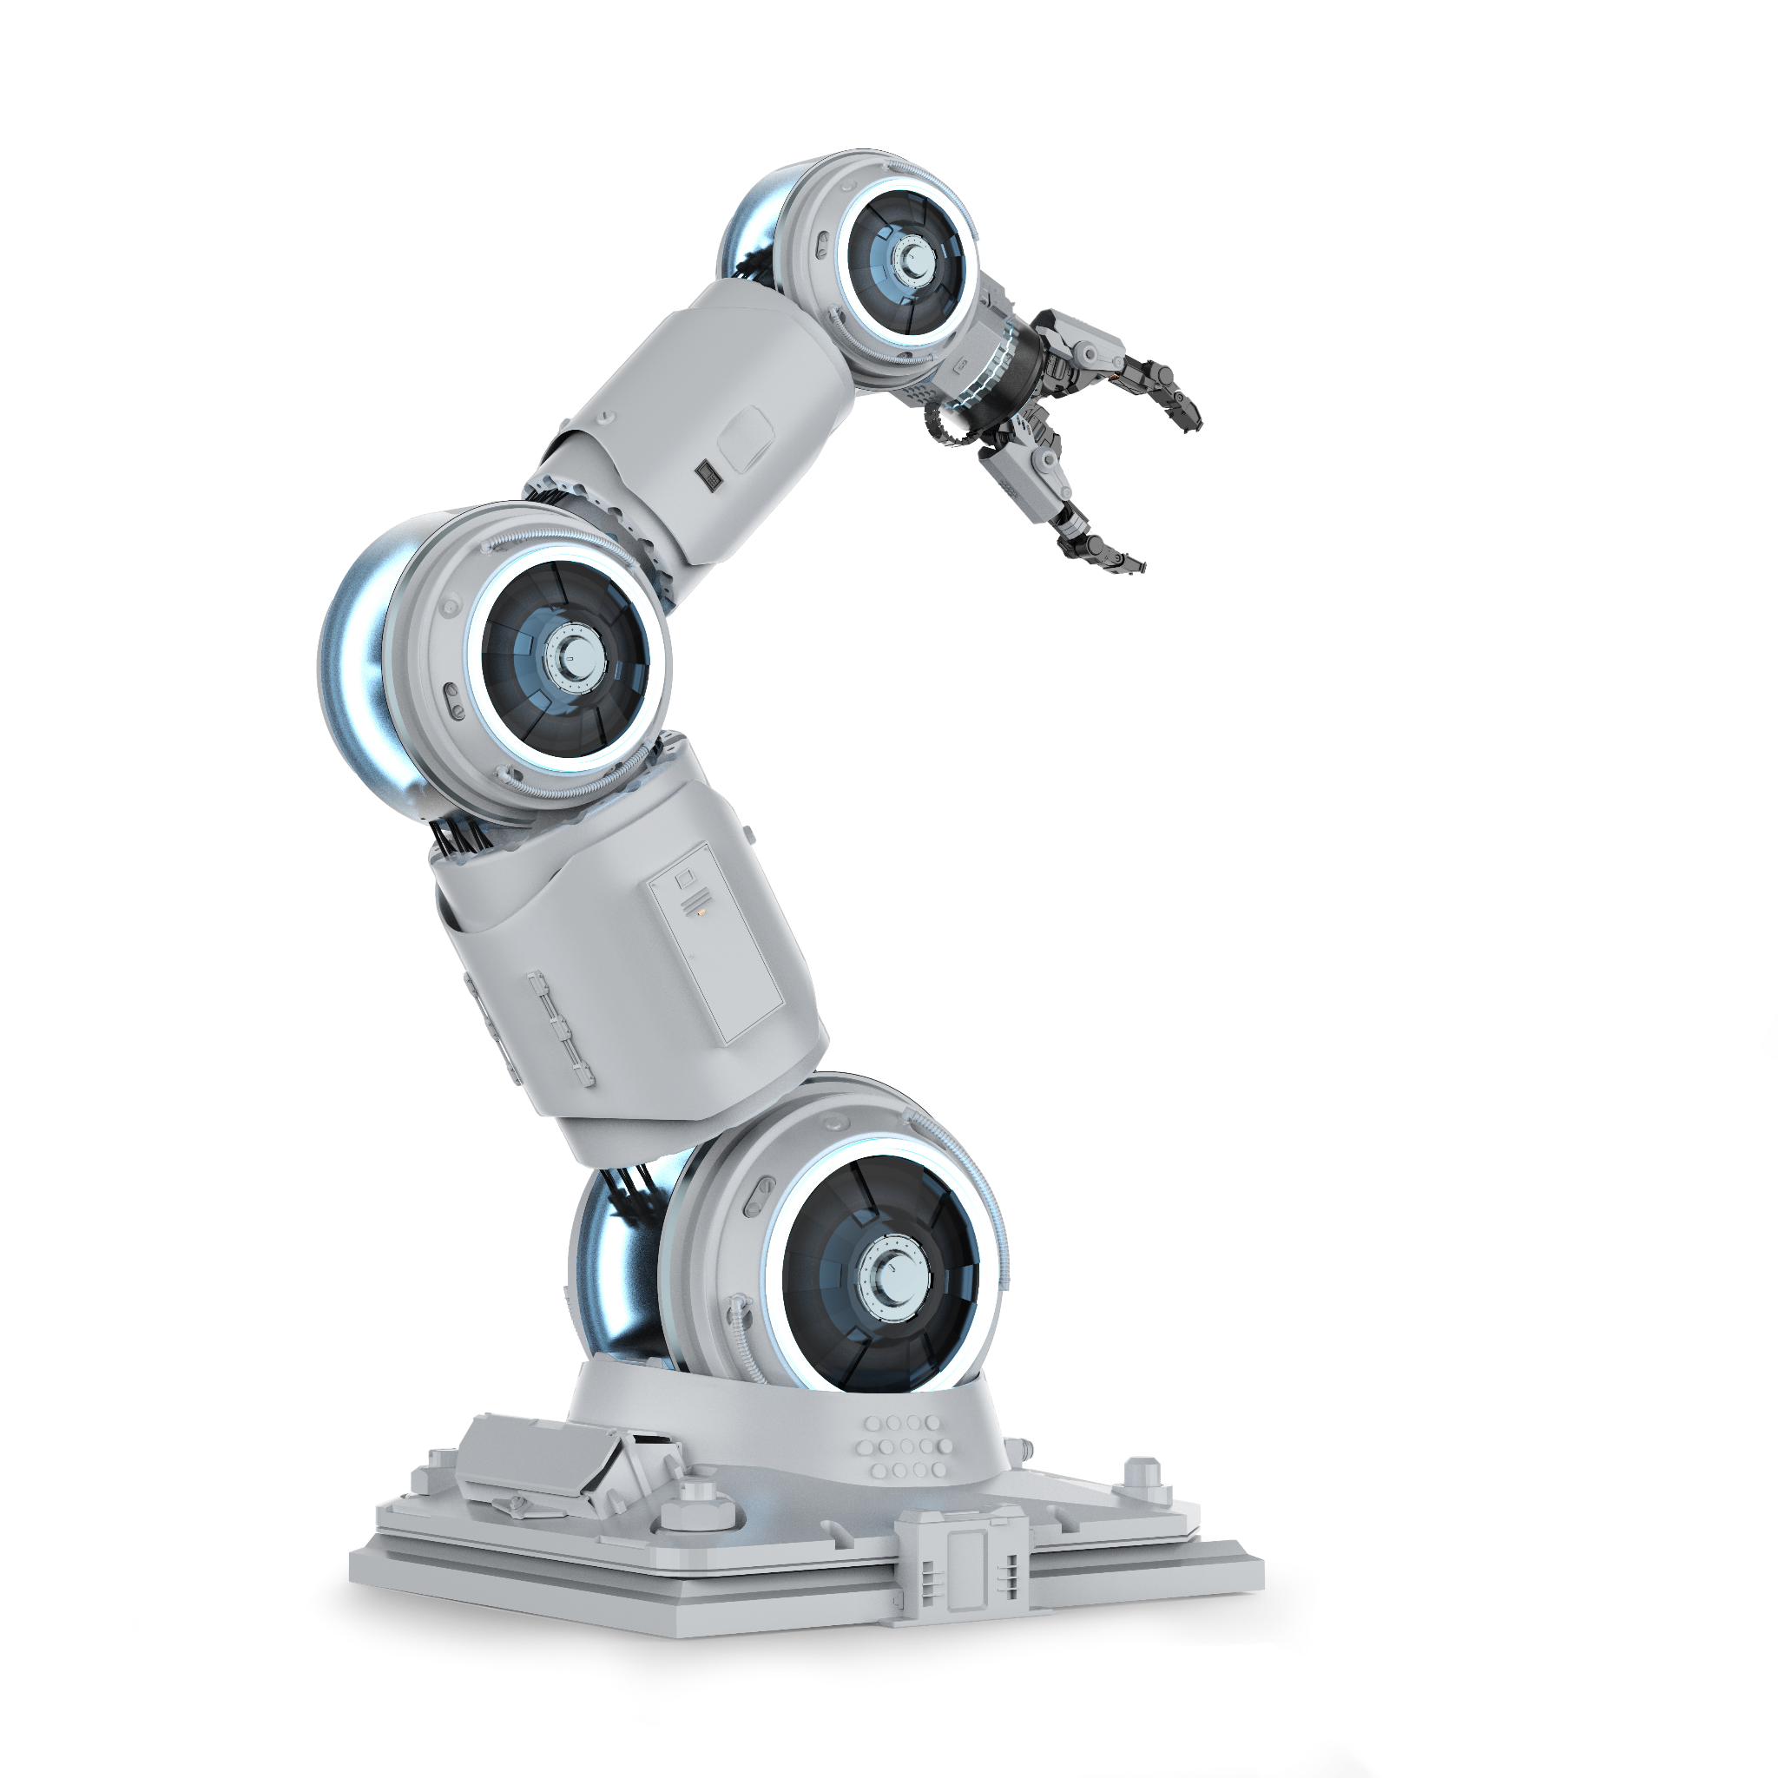
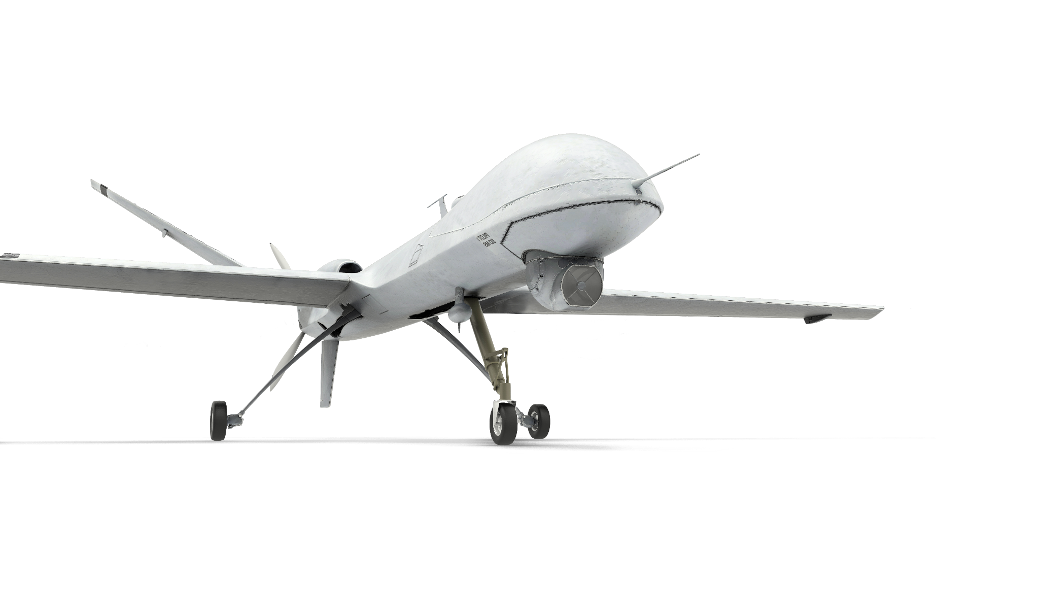
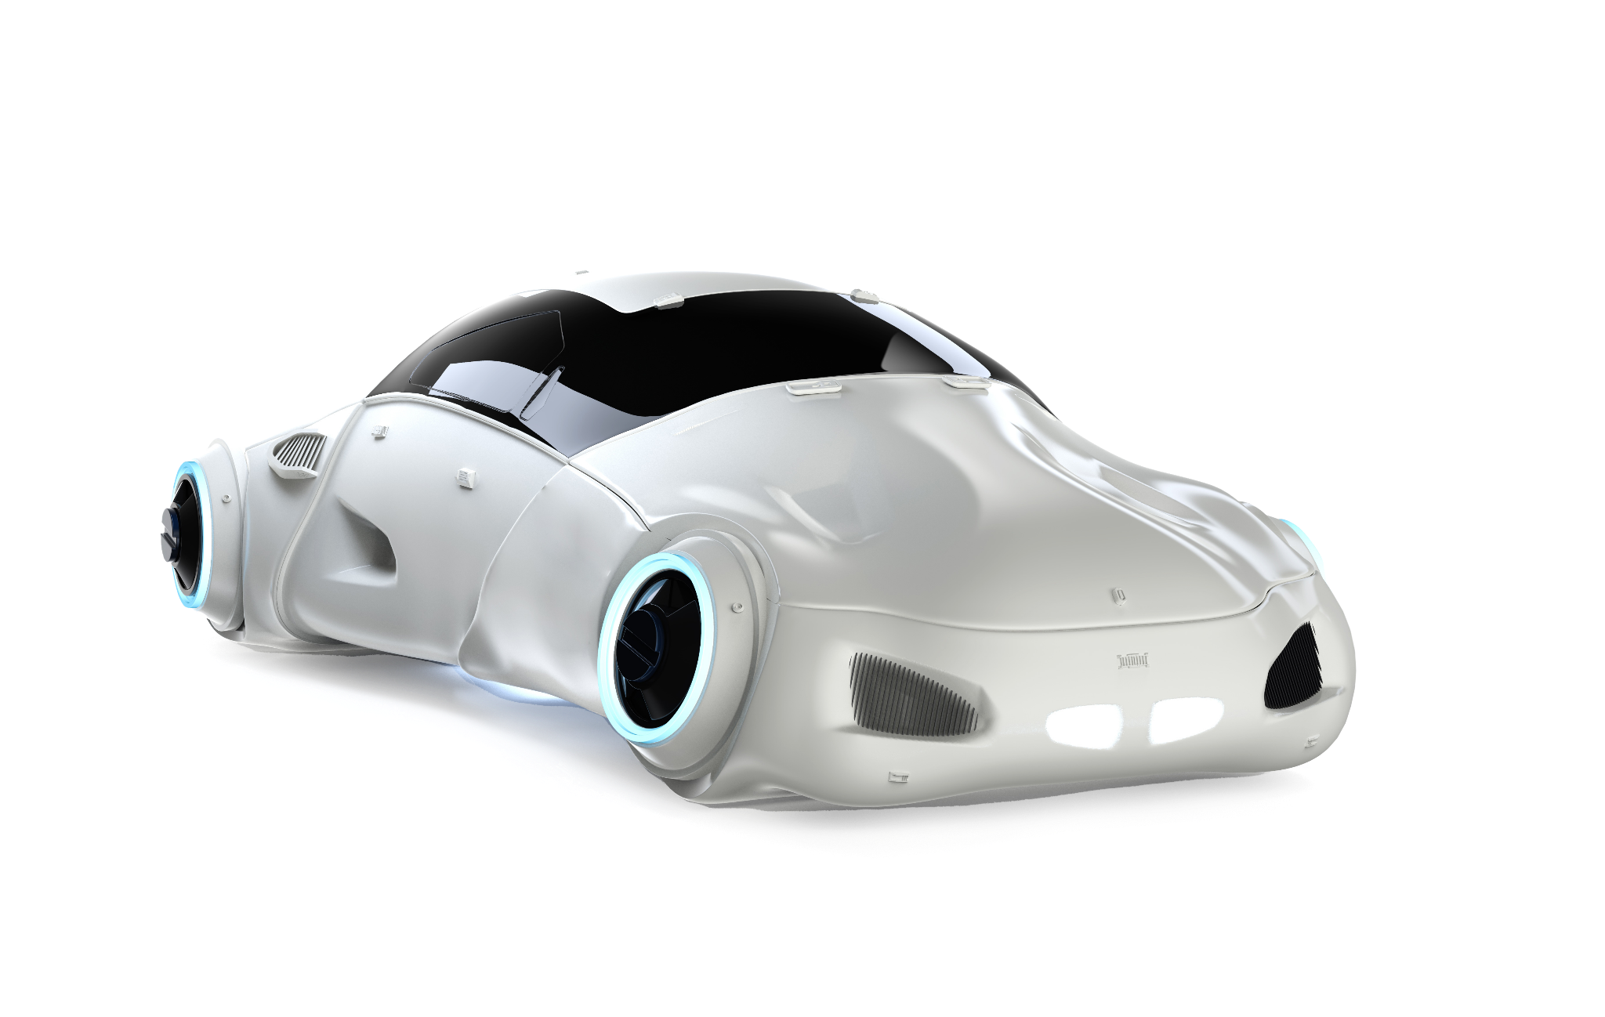
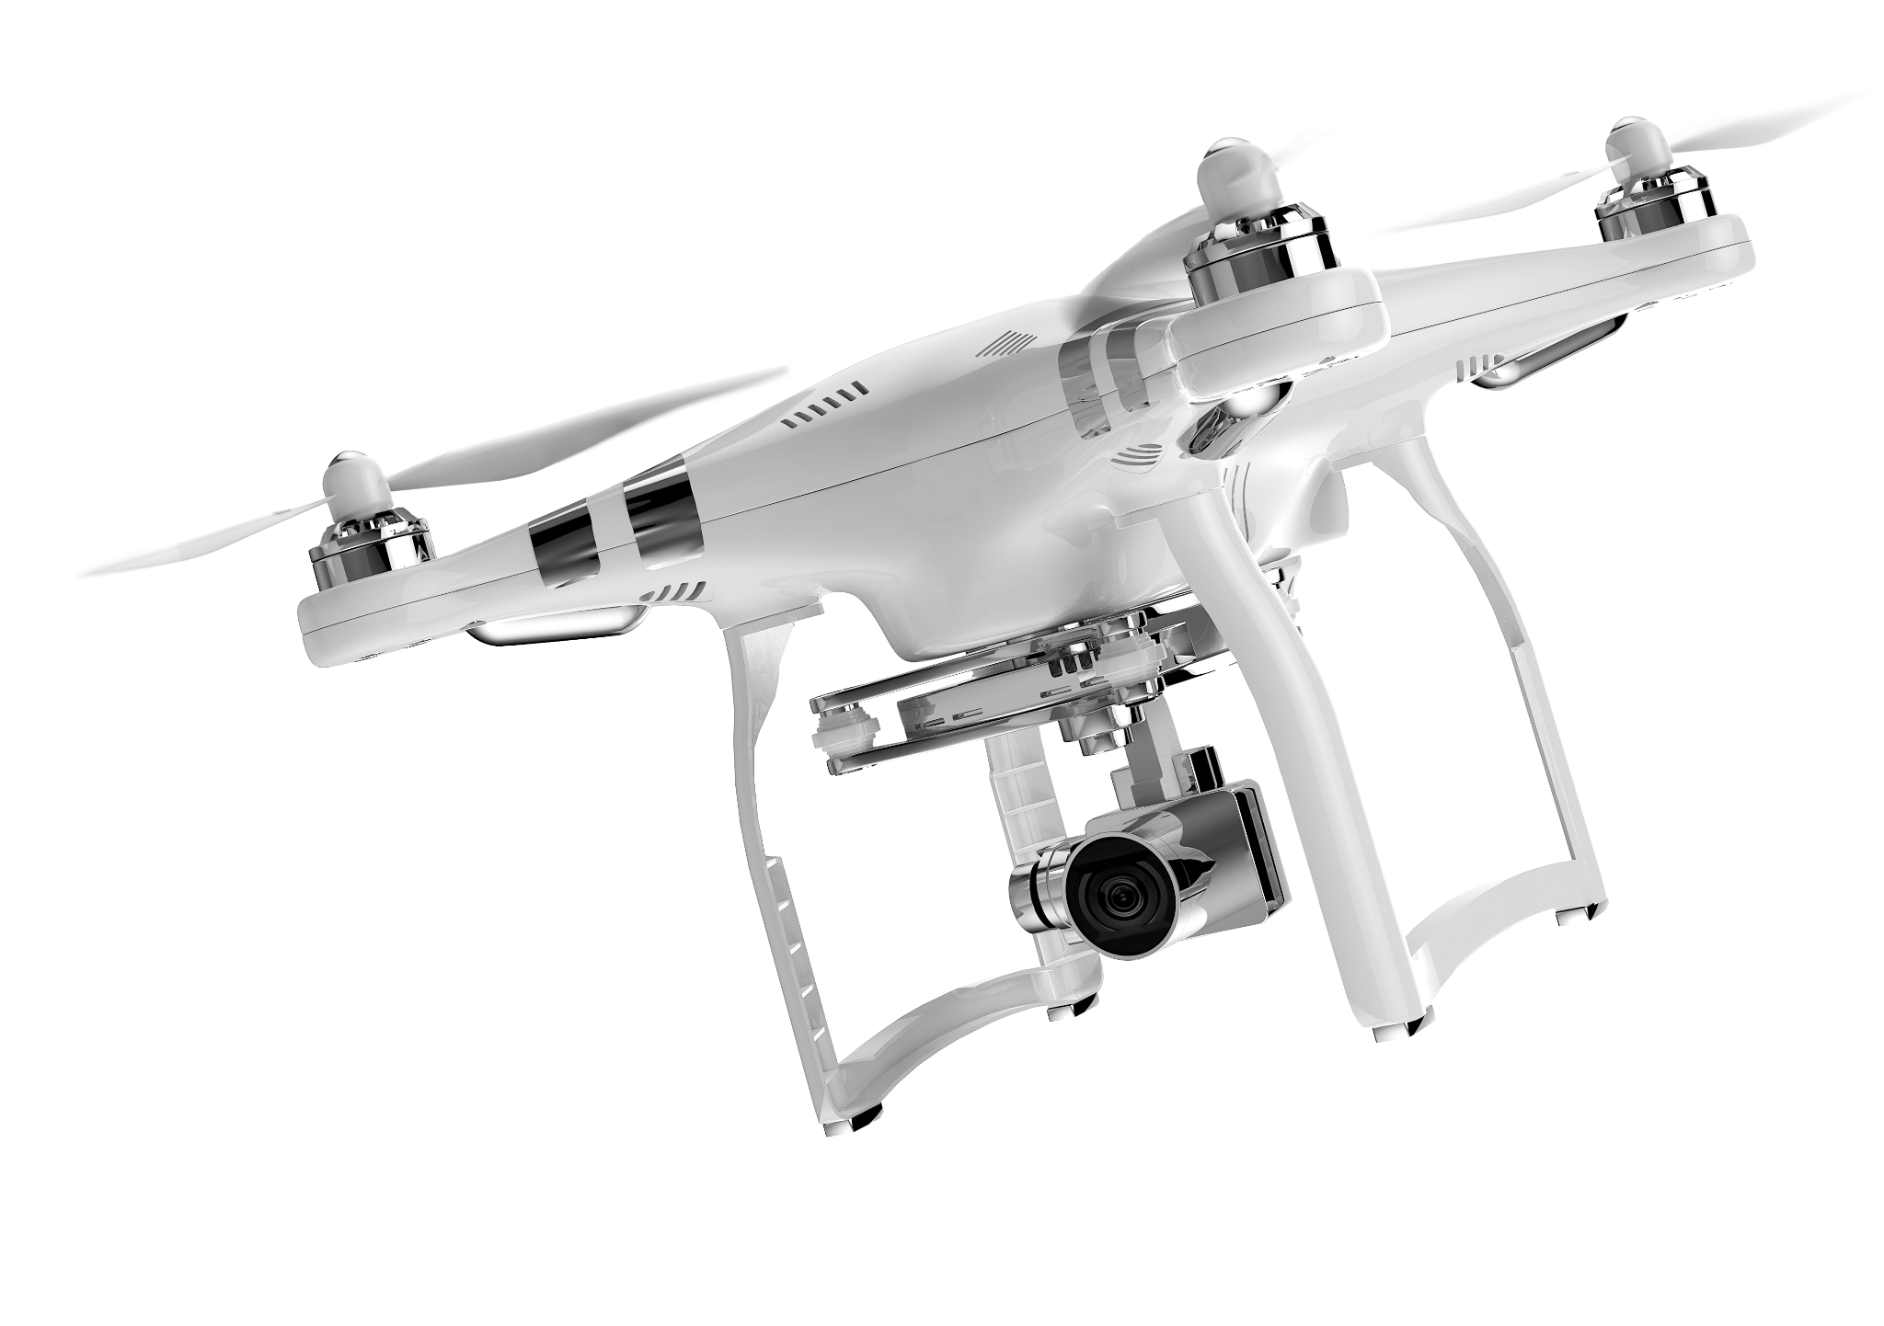
Application focused
Photography
These photos are sleek and well-lit, highlighting different applications. 3D renders may be used if they have a photorealistic quality. They may be used on any color background or in real-life situations. For the latest imagery and collateral please contact Sylvia.Loza@sima.ai

Slide 23
Trade shows
All Trade show mockups featuring SiMa.ai should be reviewed and approved by Sylvia Loza: Sylvia.Loza@sima.ai

Slide 24
Questions?
Contact:
Sylvia Loza
Sylvia.Loza@sima.ai

